Slide 1


Slide 2
Minor Project - I
In
Third year – Fifth Semester of
Bachelor of Technology
specialization
In
Oil & Gas Informatics

Slide 3
Project title-: Text Analysis Using Hierarchical Approach

Slide 4
Group Member
Name: Yash jangid
Name: Rishabh Mishra
Name: Abhinav Kamboj
Name: Arjun Gupta
SAP-ID:500071155
SAP-ID:500069163
SAP-ID:500069178
SAP-ID: 500069279
Under the supervision of
Mr. Rahul Kumar Singh
Assistant Professor
Department of Informatics

Slide 5
Contents
Introduction
Objective
Methodology
Algorithm
Code output
Current status of the project
References

Slide 6
Introduction
In this project analyzing a given set of texts using various Tokenization approaches.
Using parsing tree algorithm and other hierarchical approaches for breaking down text document apart into those pieces.
Then have to take a set a words in any language and analyses them according to the grammar rule and the translate the given set of words in another preferred language in which want to translate them.

Slide 7
After building a parser tree in the first phase which is developed through the Top-Down approach parser, after that have to perform a language conversion in which we have to processed the given grammar or a set of words and translate into another language in which have to translate.
And this translation is also consists or performed by parser algorithm itself.
The output get from first phase in the form of a tree,use it as a input for out second phase and have to processed the words in a Bottom-Up approach of parser, accordance to the grammar rules of context free grammar and of the language in which to translate the given language.

Slide 8
PHASE I-:
These process are done in both languages simultaneously.
This project is build to analyze set of texts using different approaches like parsing tree algorithm and other hierarchical approaches and convert it in another language.
For this first take a word set for tokenization.
After tokenization arrange the pre-processed data according to the modified rule of context free grammar to maintain grammar rule in text.
After arranging text put text into a hierarchical form, with the help of parse tree algorithm .

Slide 9
PHASE 2-:
After preprocessing analyzing the set of words accordance to their rules which have to interchange the words in other language.
. The language in which have to convert the text is also processed with the same set of modified grammar rules, and convert the whole text into another language.
After building a parser tree and analyze the same with top-down parser approach, then perform a language conversion by translating a given set of word into the another language.
And this translation is also consists or performed by parser algorithm itself, the output from first phase in the form of a tree, use it as a input for out second phase and processed the words in a Bottom-Up approach of parser

Slide 10
Objective
We have to present :-
Preprocessing and tokenization
Part of speech tagging for feature extraction
Hierarchical representation of text
Occupancy estimation and optimization

Slide 11
Methodology
In order to complete the project, we have to divide the project into different segments . This project is divided into some segments.
Gives the introduction about language and Machine translation system.
Defines the various divergence of languages occurs during translation of language with recommendation to handle them.

Slide 12
Then we have to define the various modules used to proposed Machine translation system.
Source language preprocessing
part of speech tagger
Language tree generation
Parse tree generation for parsing table
Fourth segment gives the details of data dictionary , various rules base, tagged corpus and technology used for implementing the purposed system.
Defines the evaluation methods used for the evaluation of the purposed system with the comparison of existing system.

Slide 13
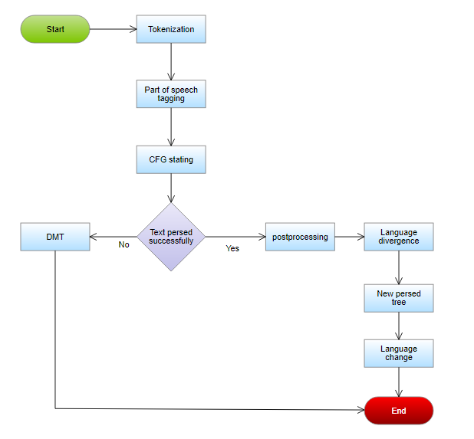
Flow chart 1

Slide 14
Algorithm
Start
Get the input as a matrix M of n*n. (n is the number of words in a line)
Then, for ( i ← 0 to n-1) (i is the number of rows in a matrix M)
Print the principal diagonal matrix M as a leaf node
Leaf[i] ← M(i,i)
Then increment the value of i ( i ← i+1)
Take 3 arrays let there name be A, B and C of a size of n-1 sorting of right, left and parent child of the tree,
Let, a temporary variable temp = true (initialized)
And, m←0 (initialize)
For (i ←0 to n-2)
L[m] ← leaf[i]
For (j ← i+1 to n-1) where, j is the number of columns in Matrix M
If ( M ( i,j) is not equal to NULL and temp = true

Slide 15
14. Then, M(i,j) is the parent node of L[m] i.e. p[m] ← M (i,j)
15. If P[m]=’s’
16. Then, root node = P[m]
17. If j = i+1
18. Then, Leaf [j] is the right node of a tree
19. R[m] ⬅ Leaf [j], and increment the value of m by 1
20. Else
21. M(i+1, j ) is the right node of the tree, and then also increment the value of m by 1
22. i.e. R[m] ← M(i+1,j)
23. And, also update the value of temp as false
24. Else,
25. if ( M (i,j) is not equal to null and the temp value is false )
26. Then, L[m] ← P [m-1] and P[m] ← M (i,j)
27. If, P[m] = ‘s’
28. Then, root node is equal to P[m]
29. i.e. R[m] ← Leaf [j]
30. And, increment the value of m, i, j by 1 also update the value of temp as true
31. For (j←0 to n-2)
32. Return (L,P,R) same again.

Slide 16
Work done
Till now we have two test case with random word set as a sample and algorithm to build the parser tree for the first language texts. Our project is divided in four sections which are described in a methodology part, and every team member works on each and every part. In second part of our project we perform a language conversion after analyzing all the words translate it into a grammar syntax then with the help of parsing techniques we can get our translated language in accordance to the proper syntax of language.
But in second phase we have to make two parser first for manual understanding which is not mandatory, and second for technical purpose which is mandatory because in only this parser we maintain our grammar rules. The code for the same is also completed, basically it is divided into two parts first is tokenization and second is parsing analysis tree, till mid semester we have our completed tokenization code and now we have both codes completed

Slide 17
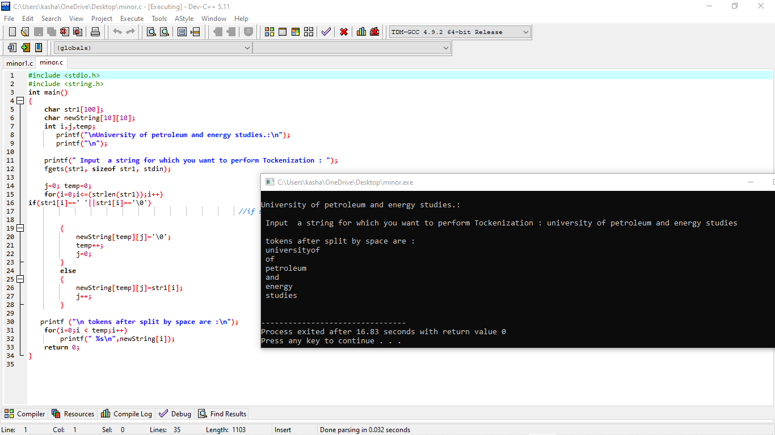

Slide 18
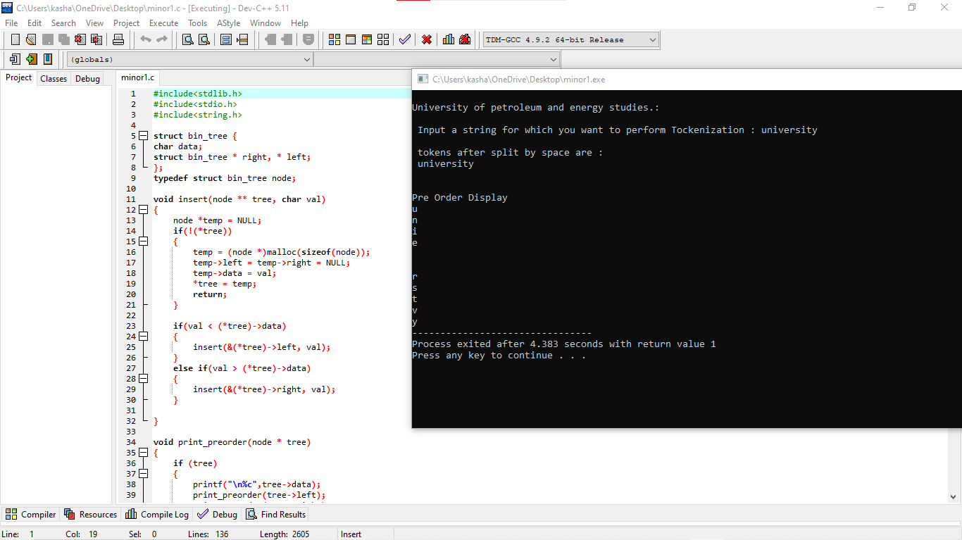

Slide 19
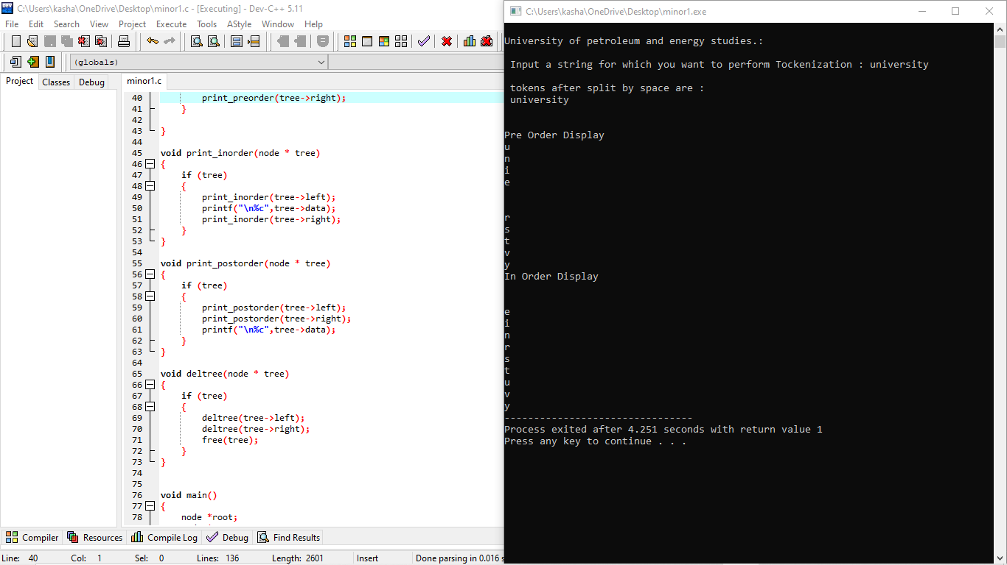

Slide 20
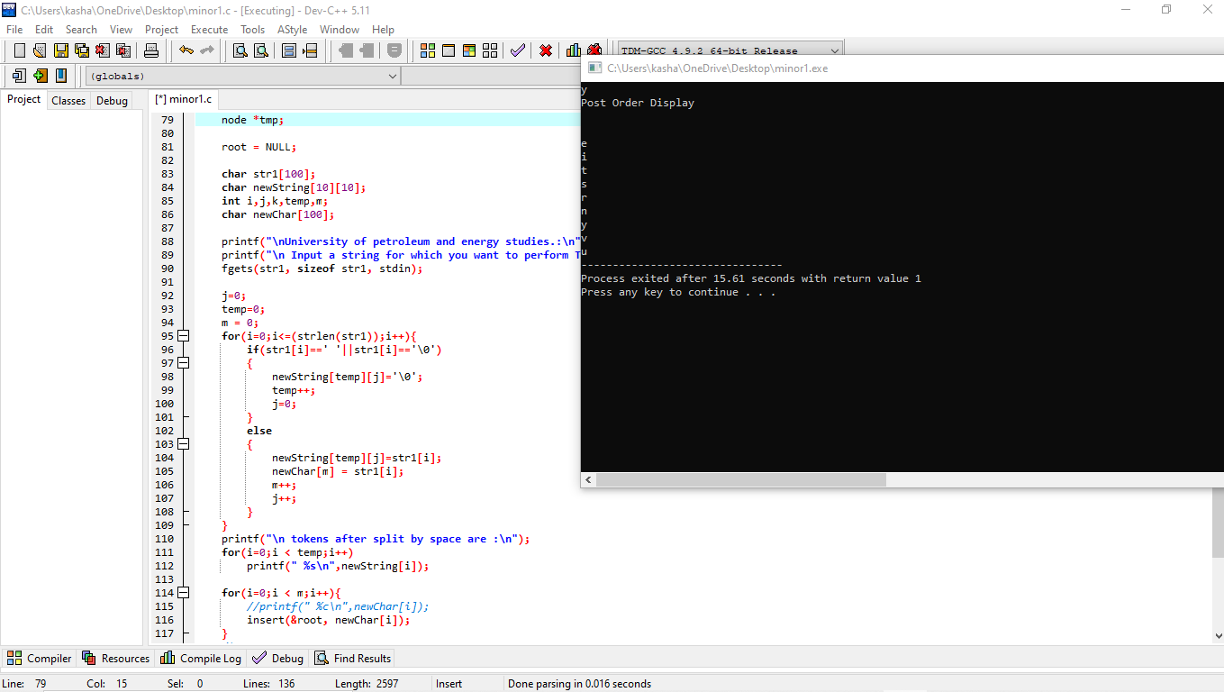

Slide 21
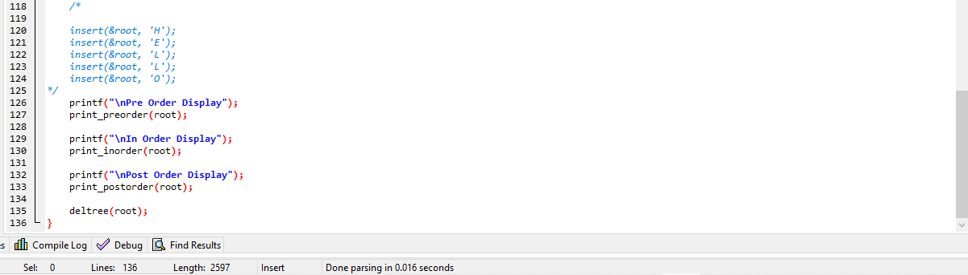

Slide 22
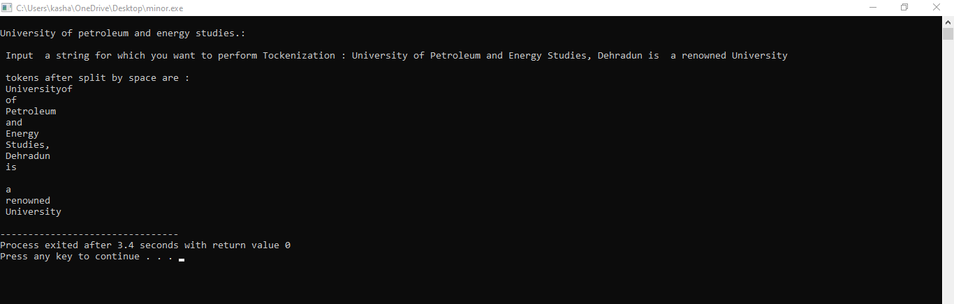

Slide 23
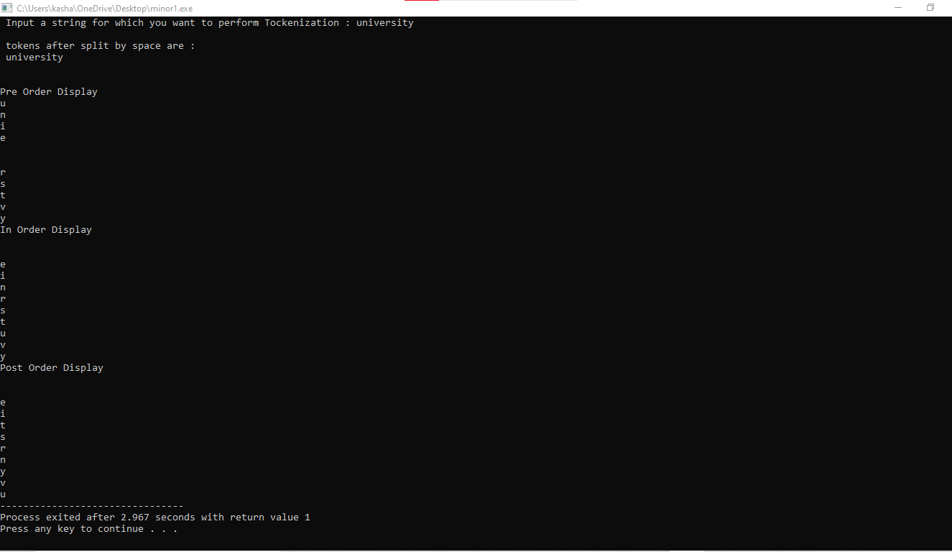

Slide 24
References
https://link.springer.com/chapter/10.1007%2F978-81-322-1143-3_4
https://www.semanticscholar.org/paper/Rule-Based-Machine-Translation-from-English-to-Rajan-Sivan/6ea3f88187905e0e6a78ad37d87fc83d49ce1eb8
https://fdocuments.in/document/ijcst-vo-l-3-iss-ue-1-jan-m-issn-0976-8491-ncst-mumbai-cdac-pune.html
https://link.springer.com/chapter/10.1007%2F978-3-540-30211-7_27
http://sanskrit.jnu.ac.in/corpora/JNU-Sanskrit-Tagset.htm
https://www.tandfonline.com/doi/full/10.1080/03772063.2018.1528187
http://sanskrit.jnu.ac.in/corpora/tagset.jsp
https://www.researchgate.net/publication/338965896_Research_Productivity_of_University_of_Petroleum_and_Energy
_Studies_during_2004-2018_A_Scientometric_Analysis

Slide 25
Thank You

